Slide 1
NEW AMERICA TO GO CATERING PUNCHOUT
AMERICA
TO GO

Slide 2
America To Go Punchout Landing Page

Slide 3
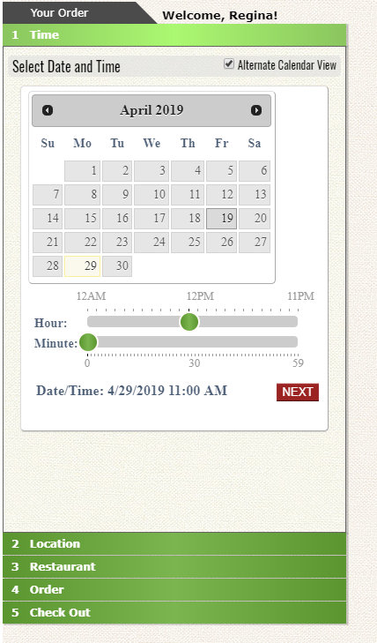
TIME
Choose a day and time for your order to be delivered/picked up.
If you are confirming an order, you can choose a date and time in the past.
Be sure to click next or it will allow you to choose from the restaurant menus.

Slide 4
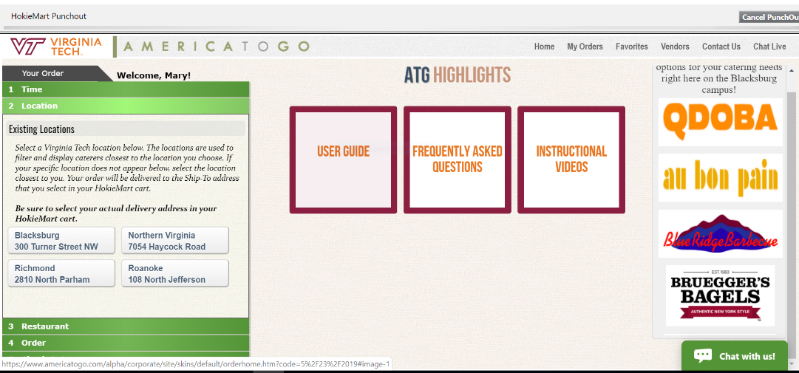
LOCATION
Selecting a location helps filter the caterers that serve that area/region.
This is meant to be a filter to filter out vendors out of your area.
When you click on the campus where you are located, the restaurants in that area will be available to view.

Slide 5
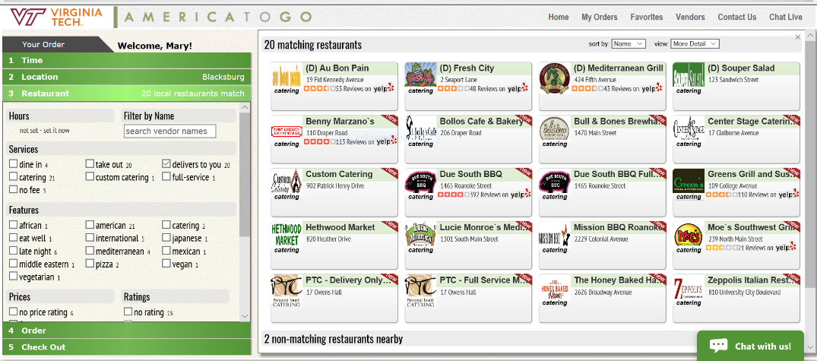
RESTAURANT FILTER
This can be used to filter down to specific kinds of restaurants by hours, features, prices, ratings, etc.
If there is no need to filter, click on 4. Order line.

Slide 6
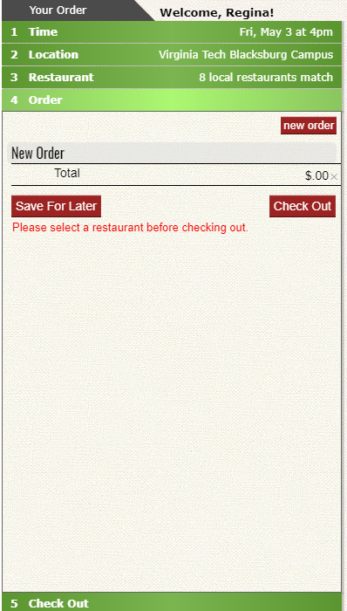
ORDER
This opens up the cart for a new order.
You now have to select your restaurant from the buttons shown.

Slide 7
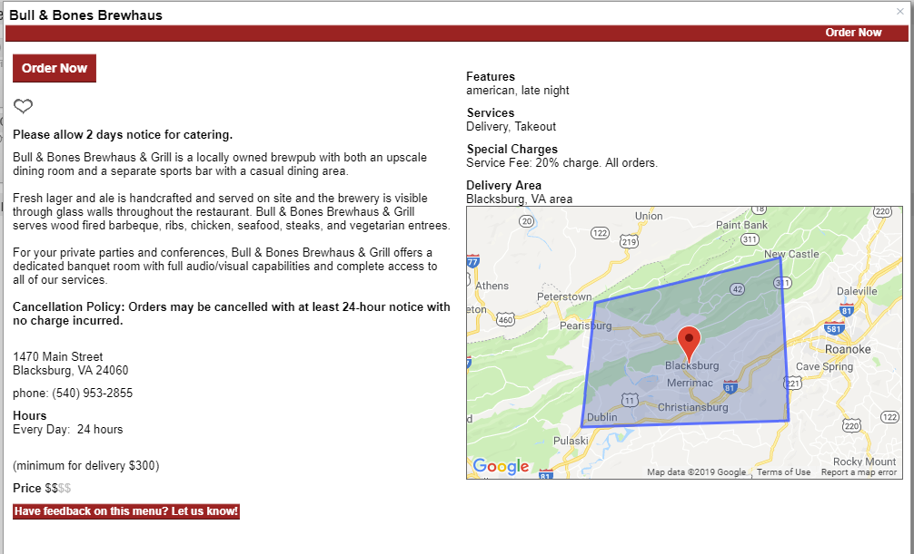
Restaurant Landing Page
This page will open that will give you information
about the restaurant along with info on any fees, minimums,
special times, delivery areas, etc.
Click on Order Now and Menu will open.

Slide 8
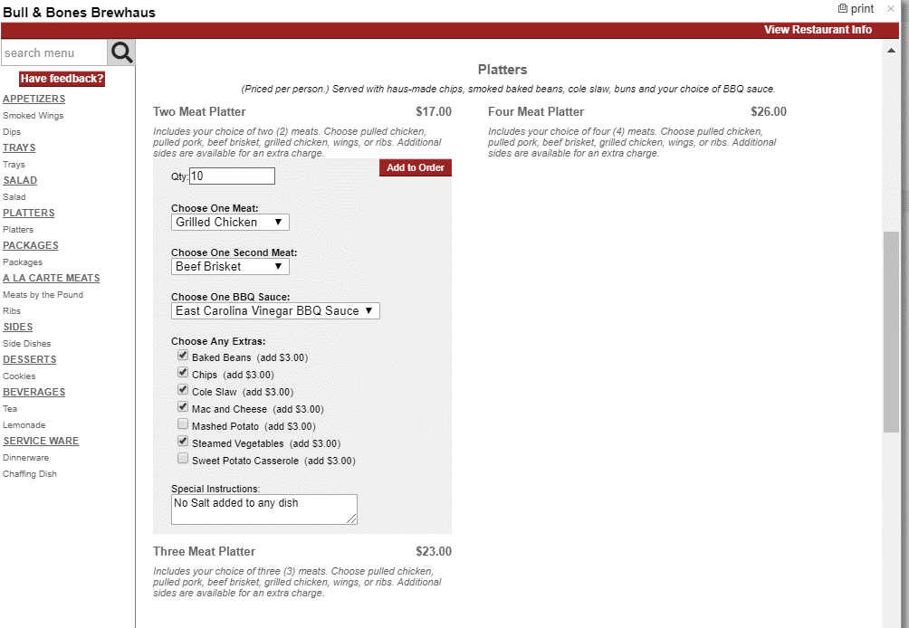
Placing the order from the Menu
You may move down the page by using the scroll bar or by the Side Bar showing the various sections.
Find the desired item and click on it.
Each menu is slightly different. It may be an item that only needs a quantity put in or an item that asks for choices of different things. Once you have made the selections, Click on Add to Order.

Slide 9
Your item/s are added to your cart
In your cart you have the option to choose Delivery or takeout according to what the restaurant allows:
1. Your item will be shown with the amount and price:
a. if there is a minimum, it will display
b. if there is a service ware option, it will display
c. if there is a service fee or delivery fee, it will be populated
d. if the tip is allowed by the restaurant, that option will be shown

Slide 10
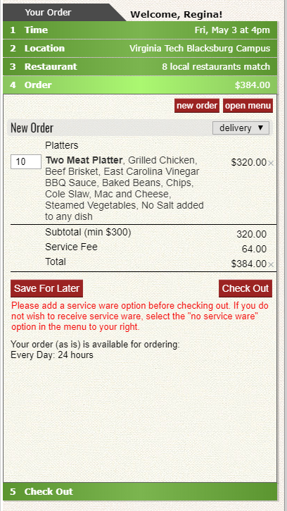
Your item/s are added to your cart

Slide 11
Your item/s are added to your cart
Continue to add items as needed then Click Check Out.
If a service ware option is required, it will remind you to choose either
a. Yes, provide service wear such as plastic plates, forks, etc.
OR
b. No, do not provide any service wear.

Slide 12
Check Out
Once all items are selected, choose “Check Out” to continue to place the order.
Save for Later allows you to save the cart for two weeks and where to go to retrieve it.

Slide 13
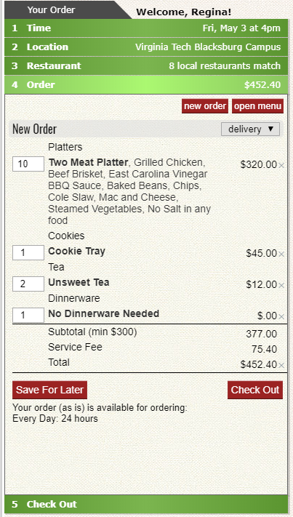
Check Out

Slide 14
Tax
When clicking on Check Out, you will be asked if this event is tax exempt. It will default to “yes” in most cases.
Only in cases in which you know that your organization has to pay tax, would you choose “yes.”
Click on “NEXT”
**Also you will notice that the beginning of your order confirmation
will be shown to the right of the cart.

Slide 15
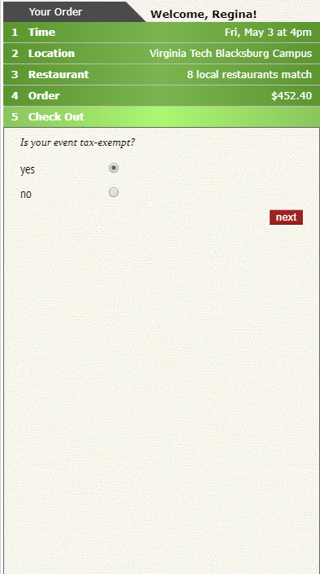
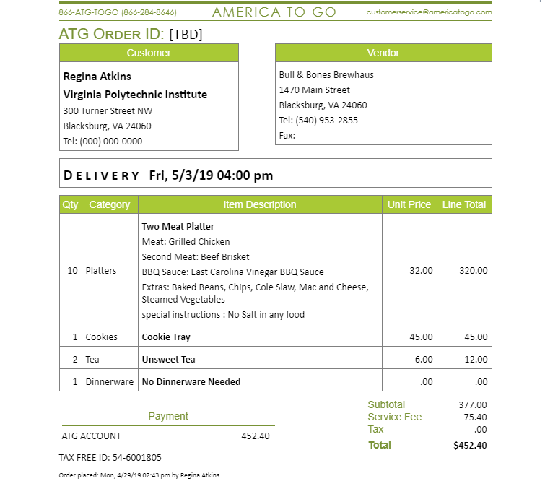
Tax

Slide 16
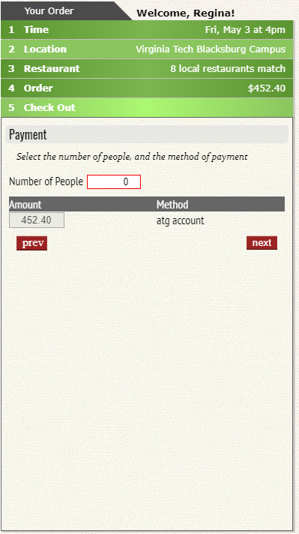
Payment
Selecting the number of people attending the event will start the systems calculation of the per diem.
Click “NEXT”

Slide 17
Payment
Notice after clicking next the info on the confirmation will update showing how much the order will be per person

Slide 18
Expense Order
Meal Type
Business Purpose

Slide 19
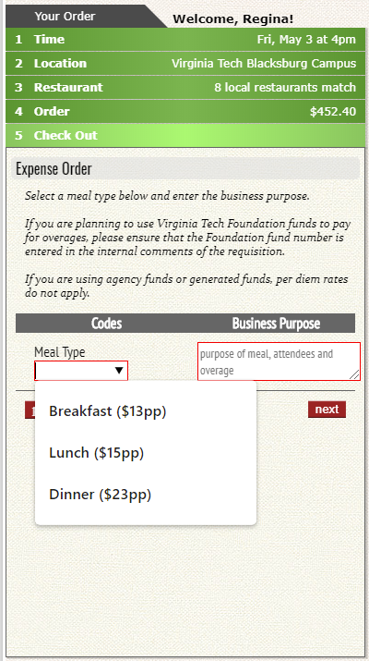
Expense Order
1. Meal Type
There are three choices for Meal
Type in the top left corner.
1. Breakfast ($13.00 per person)
2. Lunch ($15.00 per person)
3. Dinner ($23.00 per person)

Slide 20
Expense Order-Meal Type
After choosing the Meal type if your amount has exceeded the per diem rate for state funds you will get a warning message.

Slide 21
Expense Order
2. Business Purpose
What is entered in the business purpose of this order will appear
in the description of the Hokiemart order.

Slide 22
*Remember when you get to your Hokiemart cart you will have the option to send a comment to AP by choosing Catering Approval under the user search in order to get an approval for payment of your event on state funds.

Slide 23
Instructions for Delivery
Please input detailed information on where you will want your food delivered.
This is a required field so if you are picking up your order, you will still put an address in the box, but you do not need as much detail.
A cell number is also a required field whether you pick up food or have it delivered.
Click “Next” when completed.
Note: Note after clicking next the confirmation will update with the delivery instructions and contact cell phone number.

Slide 24
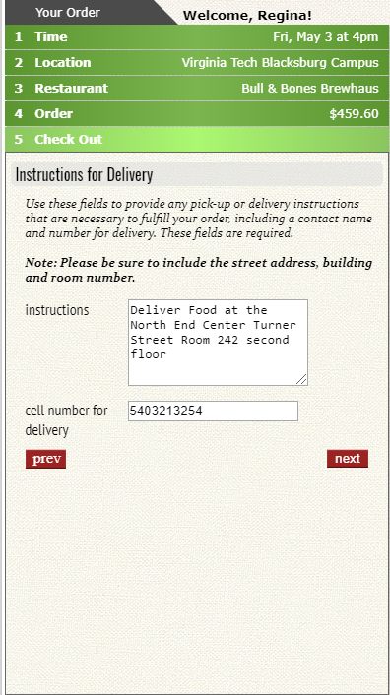

Slide 25
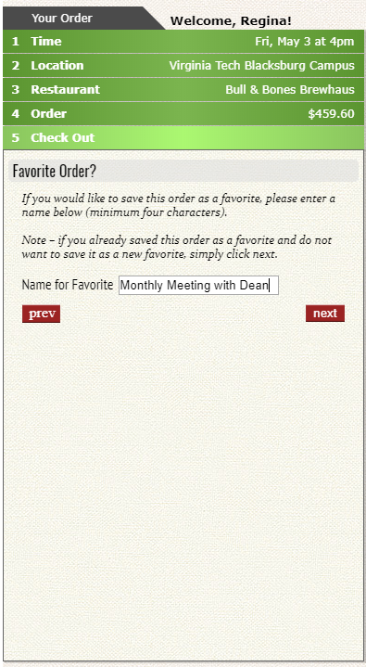
Favorites
If you want to save this order as a favorite, you can do so and Click “Next”

Slide 26
Favorites
This will be saved under Favorites in the America To Go Portal

Slide 27
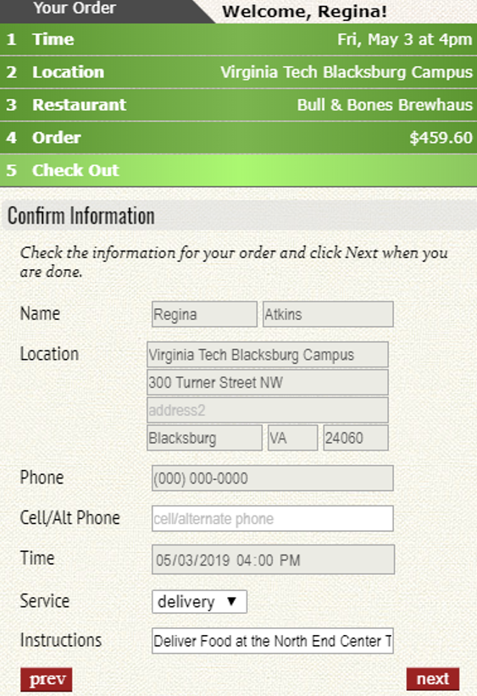
Confirmation Information
Confirmation Information defaults from user information in America To Go and from information you entered into the order you are placing.
**Do not make changes as it could cause the order to have the wrong information.

Slide 28
Submit Order
Submit now will allow your order to punch back into the Hokiemart Cart to be completed.

